Slide 1
Structures of Materials

Slide 2
The properties of a material are determined by its structure and composition
Structure occurs on many levels of scale
- Atomic and molecular level – 0.1 – 1 nm
- Nanoscale level - 1nm – 1µm
Microstructural level - 1µm – 1mm
Macrostructural level - > 1mm

Slide 3
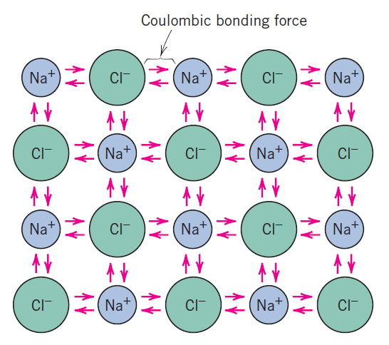
PRIMARY INTERATOMIC BONDS
Ionic bonding is found in compounds that are composed of both metallic and nonmetallic elements.
Atoms of a metallic element easily give up their valence electrons to the nonmetallic atoms.
In the process all the atoms acquire stable or inert gas configurations and, in addition, an electrical charge; that is, they become ions.
Sodium chloride (NaCl) is the classic ionic material. A sodium atom can assume the electron structure of neon (and a net single positive charge) by a transfer of its one valence 3s electron to a chlorine atom.
Schematic representation of ionic bonding in sodium chloride (NaCl).
After such a transfer, the chlorine ion has a net negative charge and an electron configuration identical to that of argon.
Ionic materials are characteristically hard and brittle and, furthermore, electrically and thermally insulative. As discussed in subsequent chapters, these properties are a direct consequence of electron configurations and/or the nature of the ionic bond.

Slide 4
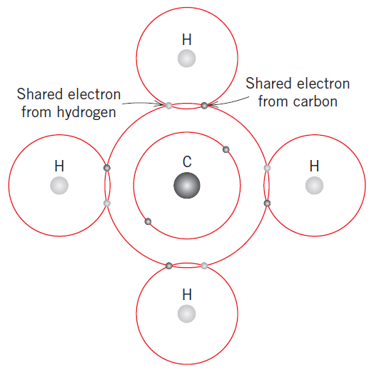
In covalent bonding, stable electron configurations are assumed by the sharing of electrons between adjacent atoms.
Two atoms that are covalently bonded will each contribute at least one electron to the bond, and the shared electrons may be considered to belong to both atoms.
The carbon atom has four valence electrons, whereas each of the four hydrogen atoms has a single valence electron.
Schematic representation of covalent bonding in a molecule of methane CH4
Covalent bonds may be very strong, as in diamond, which is very hard and has a very high melting temperature, or they may be very weak, as with bismuth.
Polymeric materials typify this bond, the basic molecular structure being a long chain of carbon atoms that are covalently bonded.
It is possible to have interatomic bonds that are partially ionic and partially covalent, and, in fact, very few compounds exhibit pure ionic or covalent bonding.

Slide 5
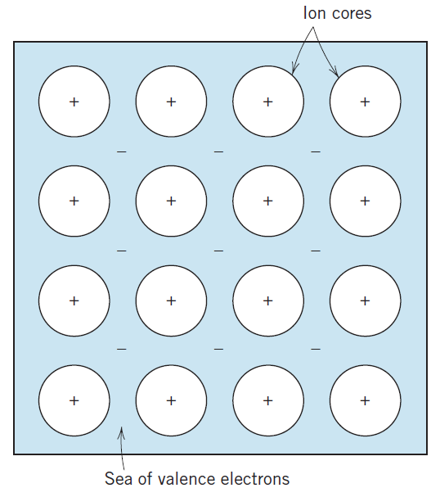
Metallic bonding, the final primary bonding type, is found in metals and their alloys.
Metallic materials have one, two, or at most, three valence electrons.
Valence electrons are not bound to any particular atom in the solid and are more or less free to drift throughout the entire metal.
They may be thought of as belonging to the metal as a whole, or forming a “sea of electrons” or an “electron cloud.”
The remaining nonvalence electrons and atomic nuclei form what are called ion cores, which possess a net positive charge equal in magnitude to the total valence electron charge per atom.
In addition, these free electrons act as a “glue” to hold the ion cores together. Bonding energies
Schematic illustration of metallic bonding.
Some general behaviors of the various material types (i.e., metals, ceramics, polymers) may be explained by bonding type. For example, metals are good conductors of both electricity and heat, as a consequence of their free electrons.
By way of contrast, ionically and covalently bonded materials are typically electrical and thermal insulators, due to the absence of large numbers of free electrons.

Slide 6
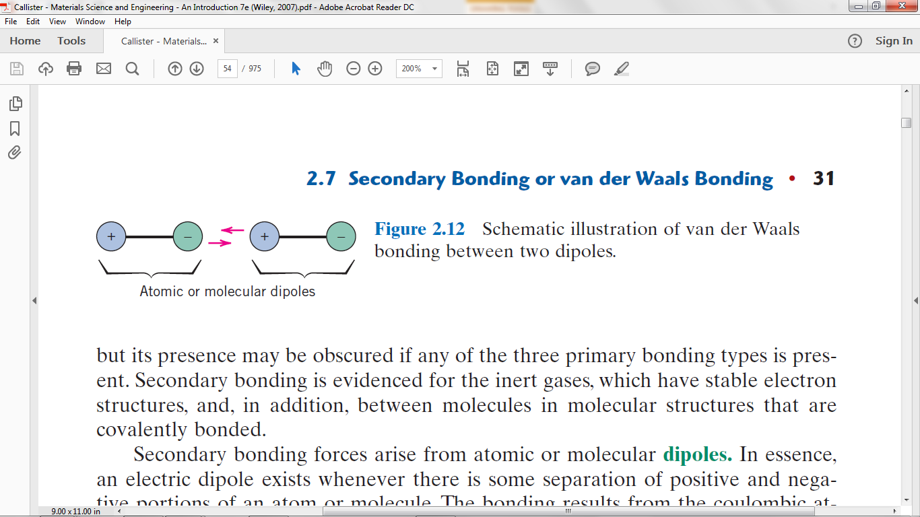
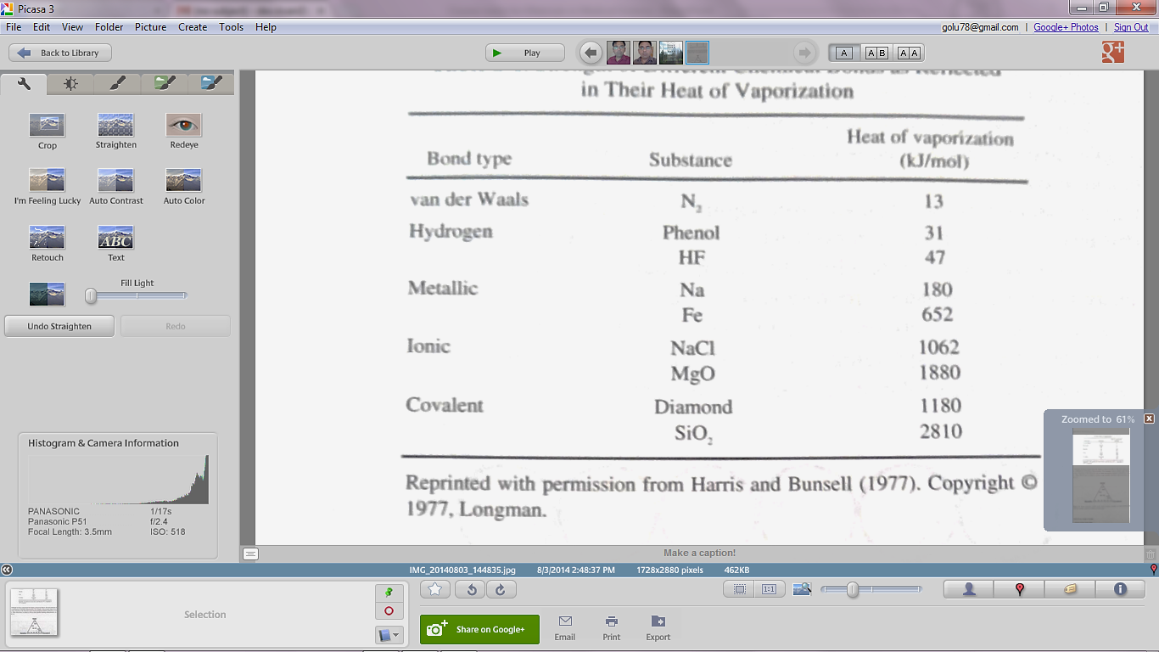
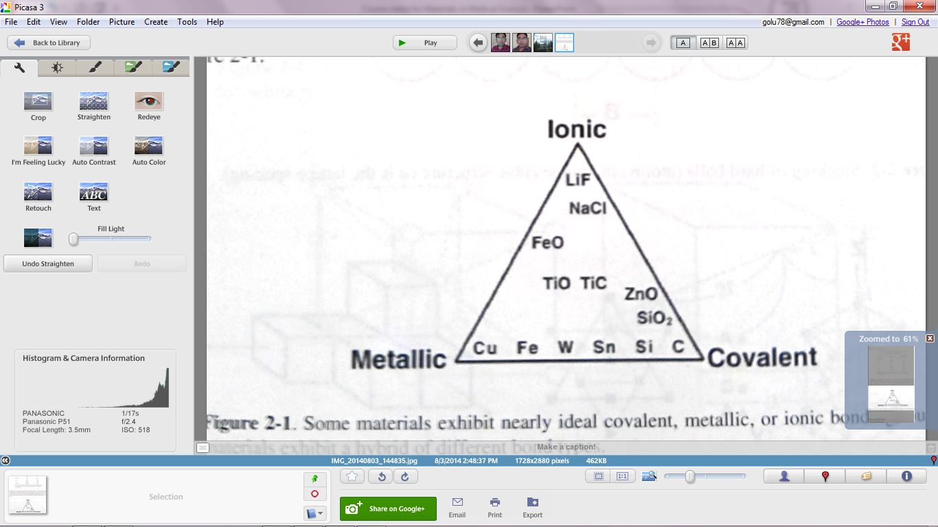
SECONDARY BONDING
Secondary, van der Waals, or physical bonds are weak in comparison to the primary or chemical ones; bonding energies are typically on the order of only 10 kJ/mol.
Secondary bonding forces arise from atomic or molecular dipoles.
The bonding results from the coulombic attraction between the positive end of one dipole and the negative region of an adjacent one.
Hydrogen bonding, a special type of secondary bonding, is found to exist between some molecules that have hydrogen as one of the constituents.

Slide 7
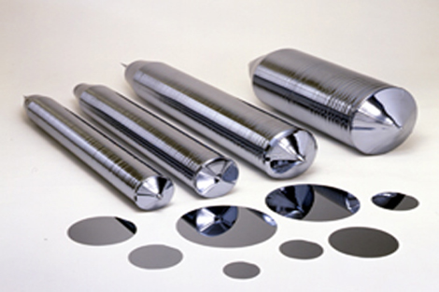
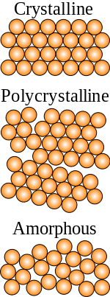
Crystal Structure
Crystal contain orderly arrangement of atoms
Single Crystalline materials - crystal lattice of the entire sample is continuous and unbroken to the edges of the sample, with no grain boundaries.
Single crystal silicon is used in the fabrication of semiconductors.
Monocrystals of sapphire and other materials are used for lasers and nonlinear optics.
Monocrystals of fluorite are sometimes used in the objective lenses of apochromatic refracting telescopes
Polycrystalline materials
- Crystalline regions are separated by grain boundaries.
Most of the materials are polycrystalline
Amorphous Materials
- Amorphous materials lacks ordered structure
- Grain boundaries are amorphous
Single crystal Silicon

Slide 8
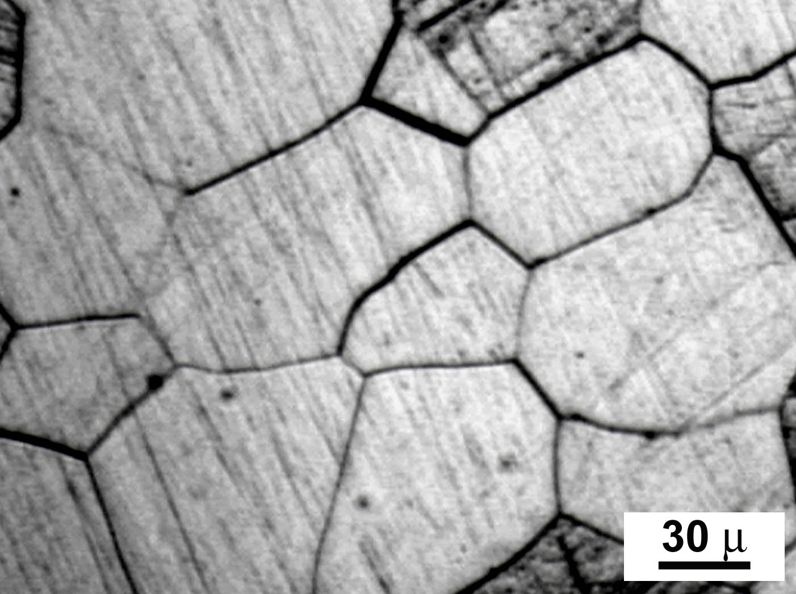
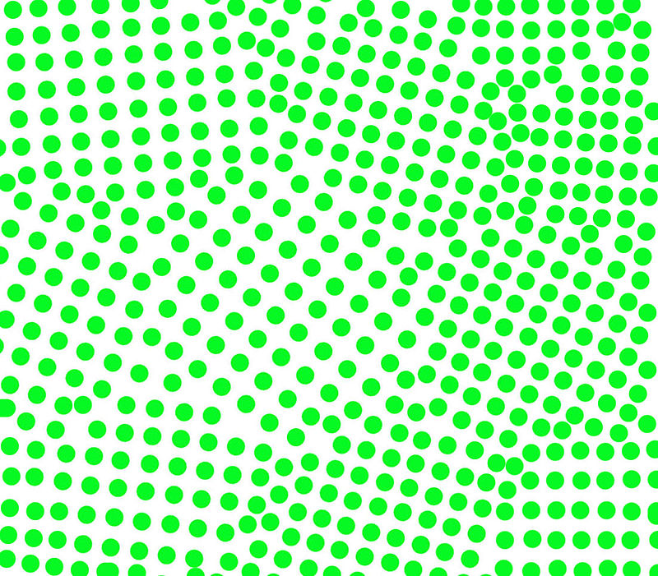
Grain boundaries
Wikipedia.com
The mechanical properties of the sample improve as the grain size decreases.

Slide 9
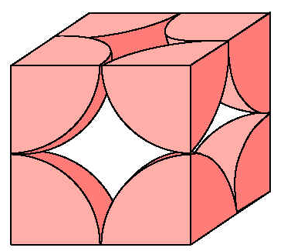
Unit cell
Small repeating entity of the atomic structure. The basic building block of the crystal structure.
a
The arrangement of atoms in crystal structure can be treated as an arrangement of hard spheres
a – lattice constant
R – radius of atom
R
Simple Cubic Structure

Slide 10
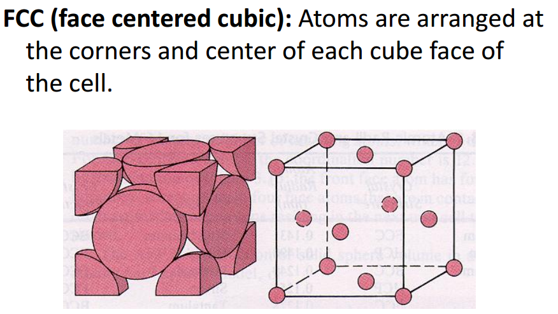
http://iit.edu/arc/workshops/pdfs/Crystal_Structures.pdf

Slide 11
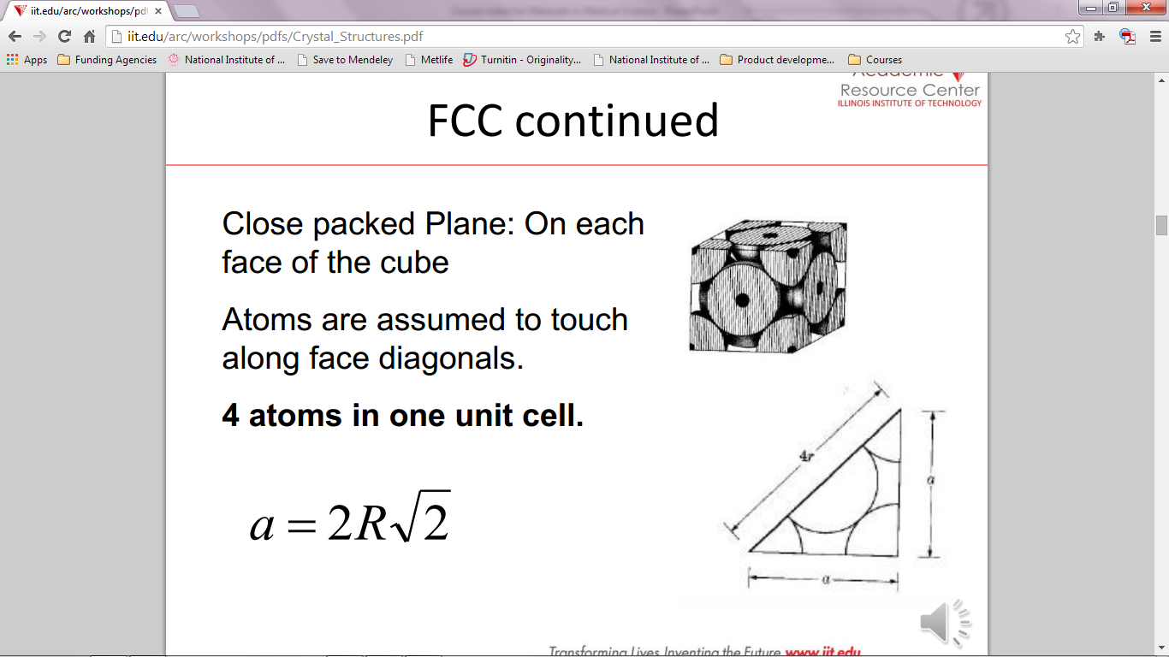
FCC continued….

Slide 12
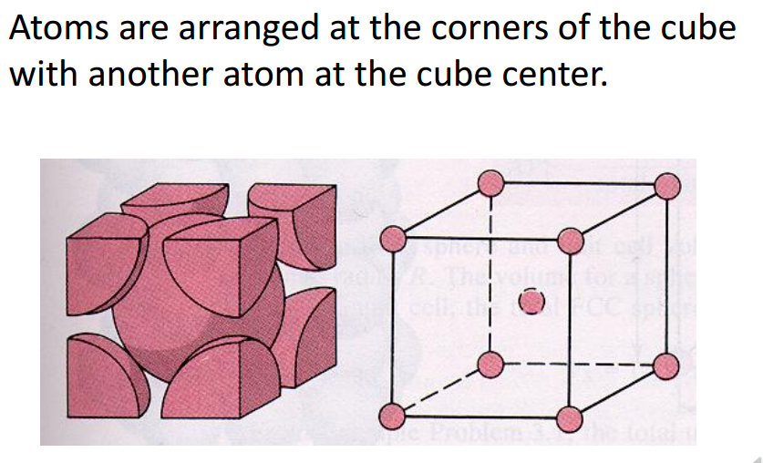
Body centered cubic (BCC)
http://iit.edu/arc/workshops/pdfs/Crystal_Structures.pdf

Slide 13
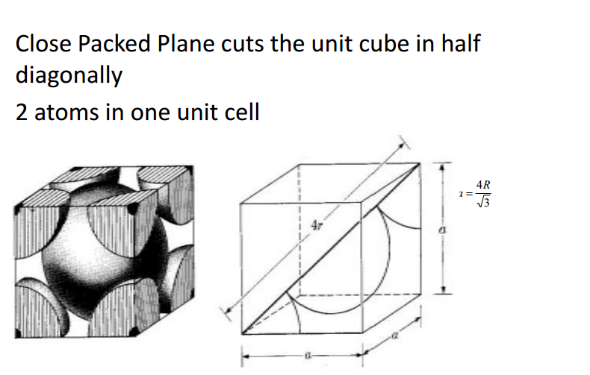
Body centered cubic (BCC) continued……
http://iit.edu/arc/workshops/pdfs/Crystal_Structures.pdf

Slide 14
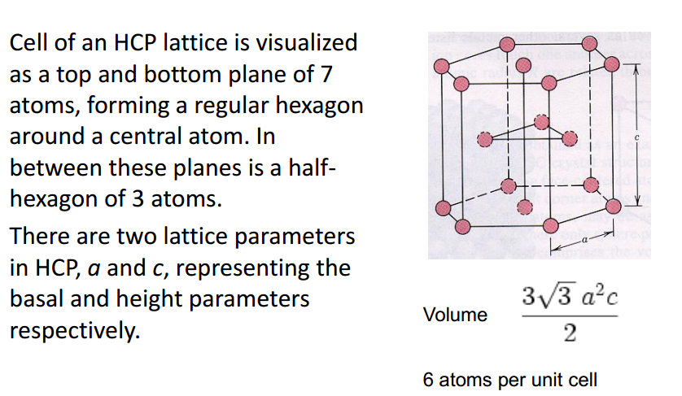
Hexagonal close packing
http://iit.edu/arc/workshops/pdfs/Crystal_Structures.pdf

Slide 15
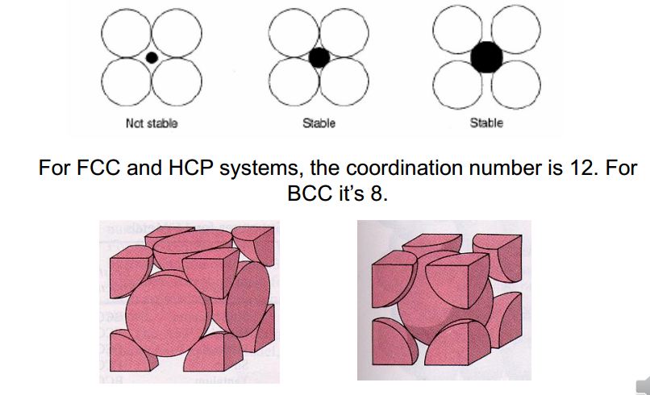
Coordination number
-the number of nearest neighbor atoms or ions surrounding an atom or ion
http://iit.edu/arc/workshops/pdfs/Crystal_Structures.pdf

Slide 16
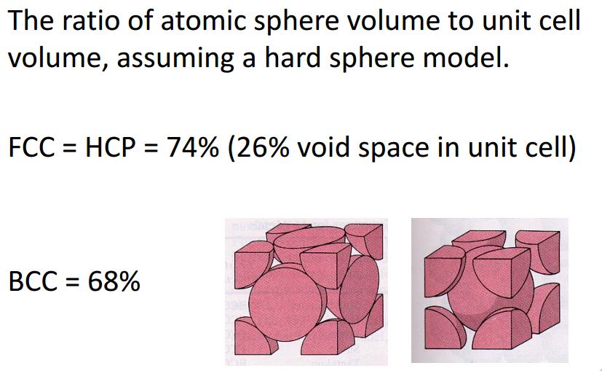
http://iit.edu/arc/workshops/pdfs/Crystal_Structures.pdf

Slide 17
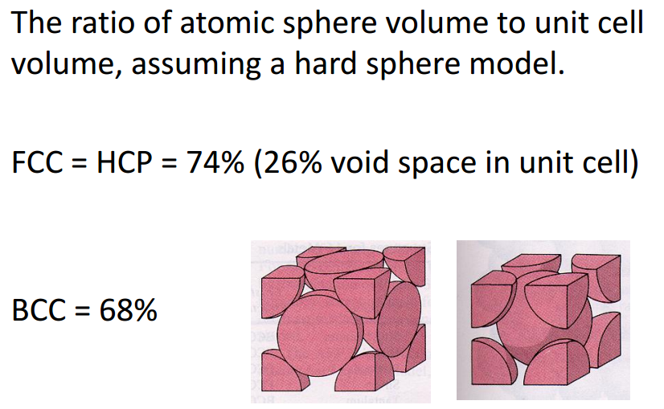
Atomic Packing Factor
http://iit.edu/arc/workshops/pdfs/Crystal_Structures.pdf

Slide 18
Problems
Iron (Fe) has a bcc structure at room temperature with atomic radius of 1.24 Å. Calculate its density (Atomic weight of Fe is 55.85 g/mol)
Assignment : What technique is used to determine the crystal structure of the materials? Explain its principle with diagram.

Slide 19
Lattice:
“lattice” means a three-dimensional array of points coinciding with atom positions (or sphere centers)
The unit cell geometry is completely defined in terms of six parameters: the three edge lengths a, b, and c, and the three interaxial angles α, β, and γ are termed the lattice parameters of a crystal structure.

Slide 21
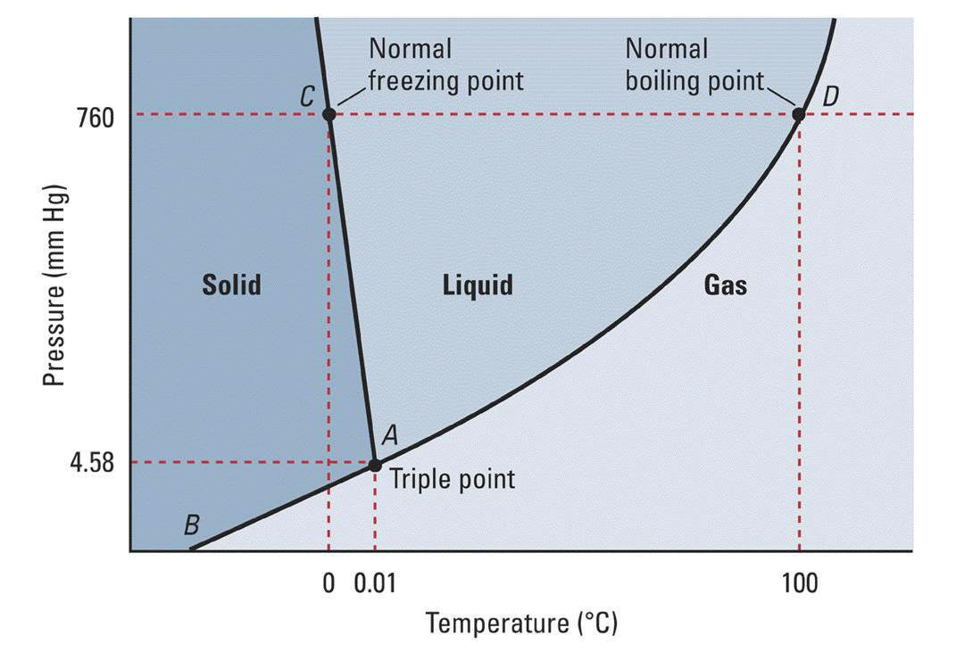
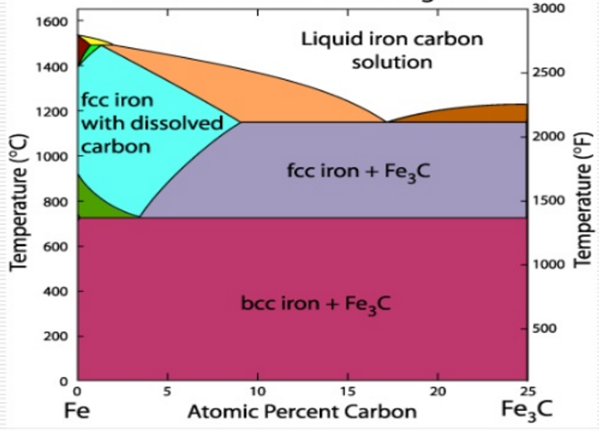
Phase
Phase diagram of water
Iron-carbon phase diagram

Slide 22
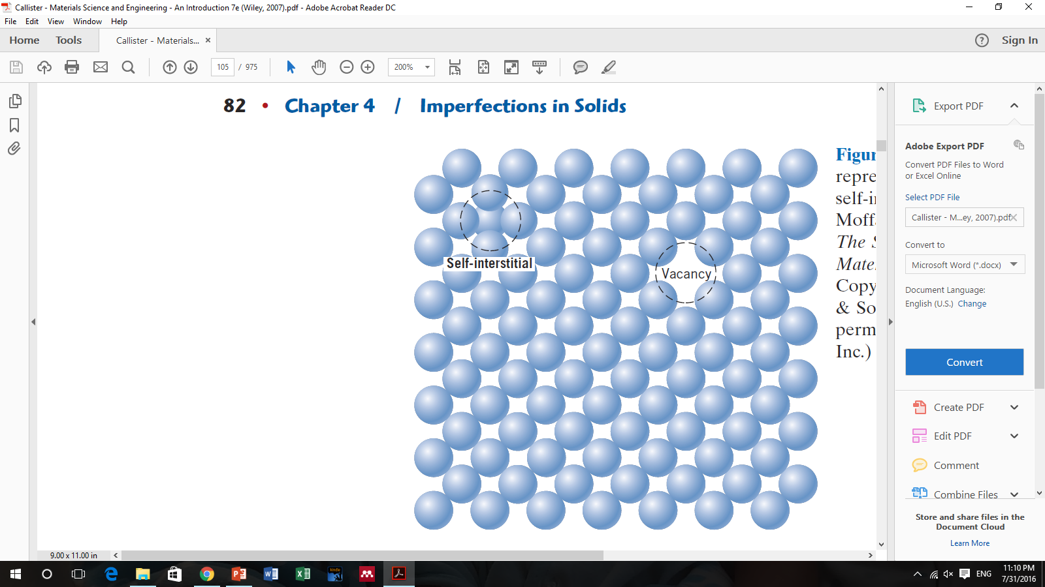
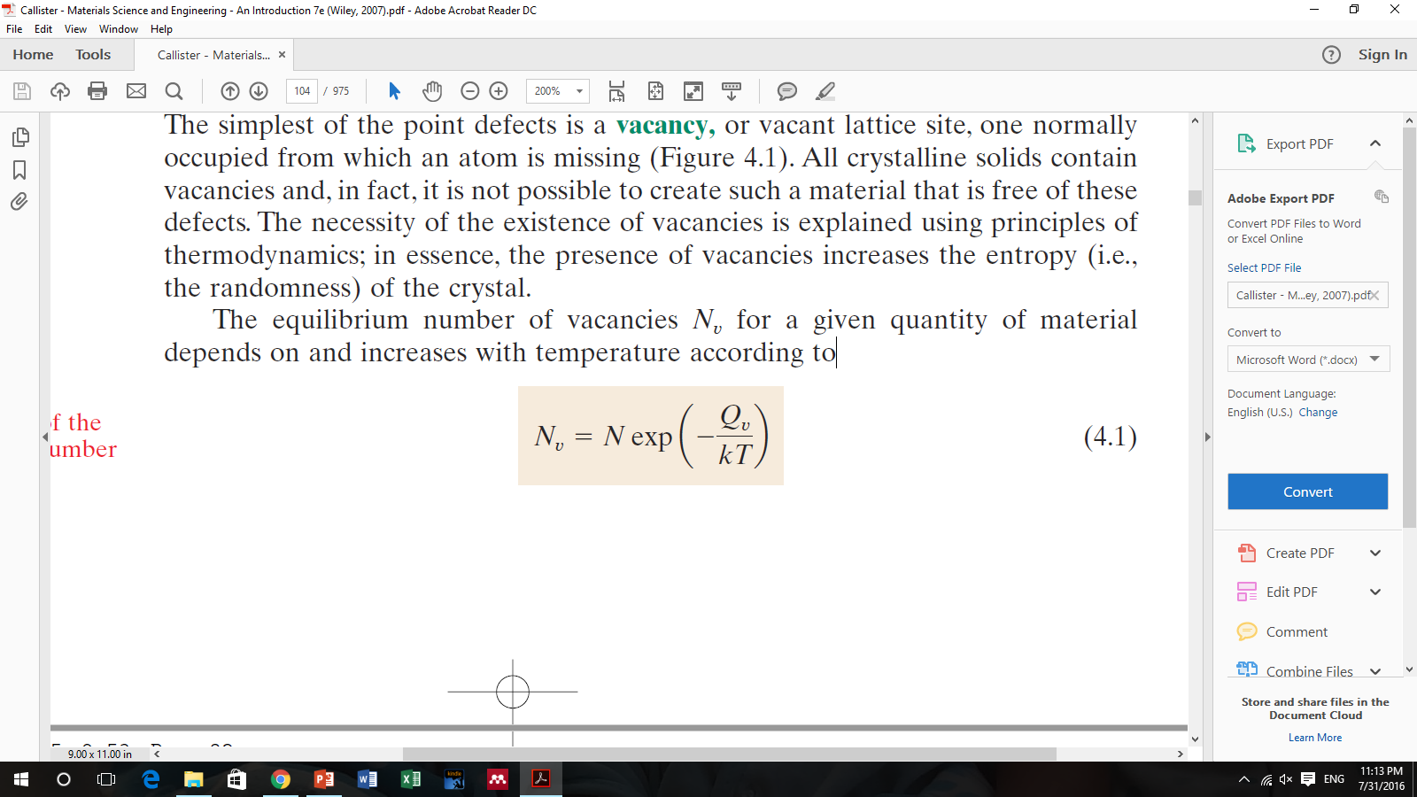
Imperfections in Solids
An idealized solid does not exist; all contain large numbers of various defects or imperfections.
Point Defects:
Vacancies and self-interstitials
The equilibrium number of vacancies N_{v} for a given quantity of material depends on and increases with temperature according to:
In this expression, N is the total number of atomic sites, Q_{v} is the energy required for the formation of a vacancy, T is the absolute temperature1 in kelvins, and k is the gas or Boltzmann’s constant. The value of k is
1.38x10²³J/atom-K,
Problem:
Calculate the equilibrium number of vacancies per cubic meter for copper at 1000⁰C. The energy for vacancy formation is 0.9 eV/atom; the atomic weight and density (at 1000⁰C) for copper are 63.5 g/mol and 8.4 g/cm³, respectively.
(Ans: 2.2 10²⁵ vacancies/m³)

Slide 23
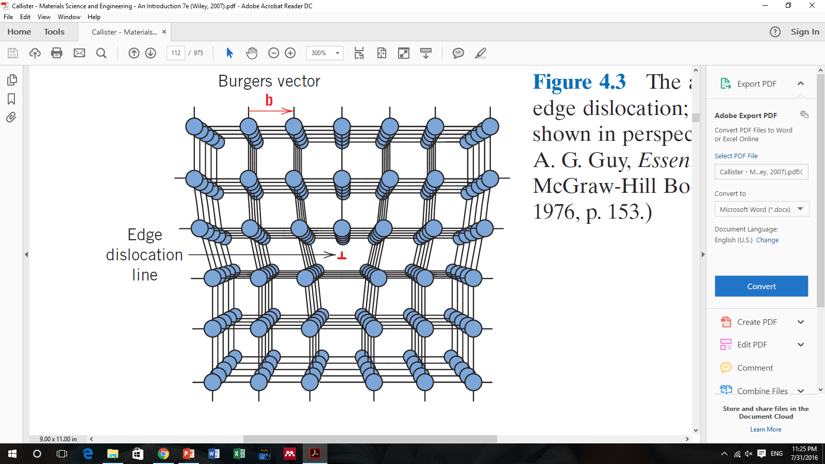
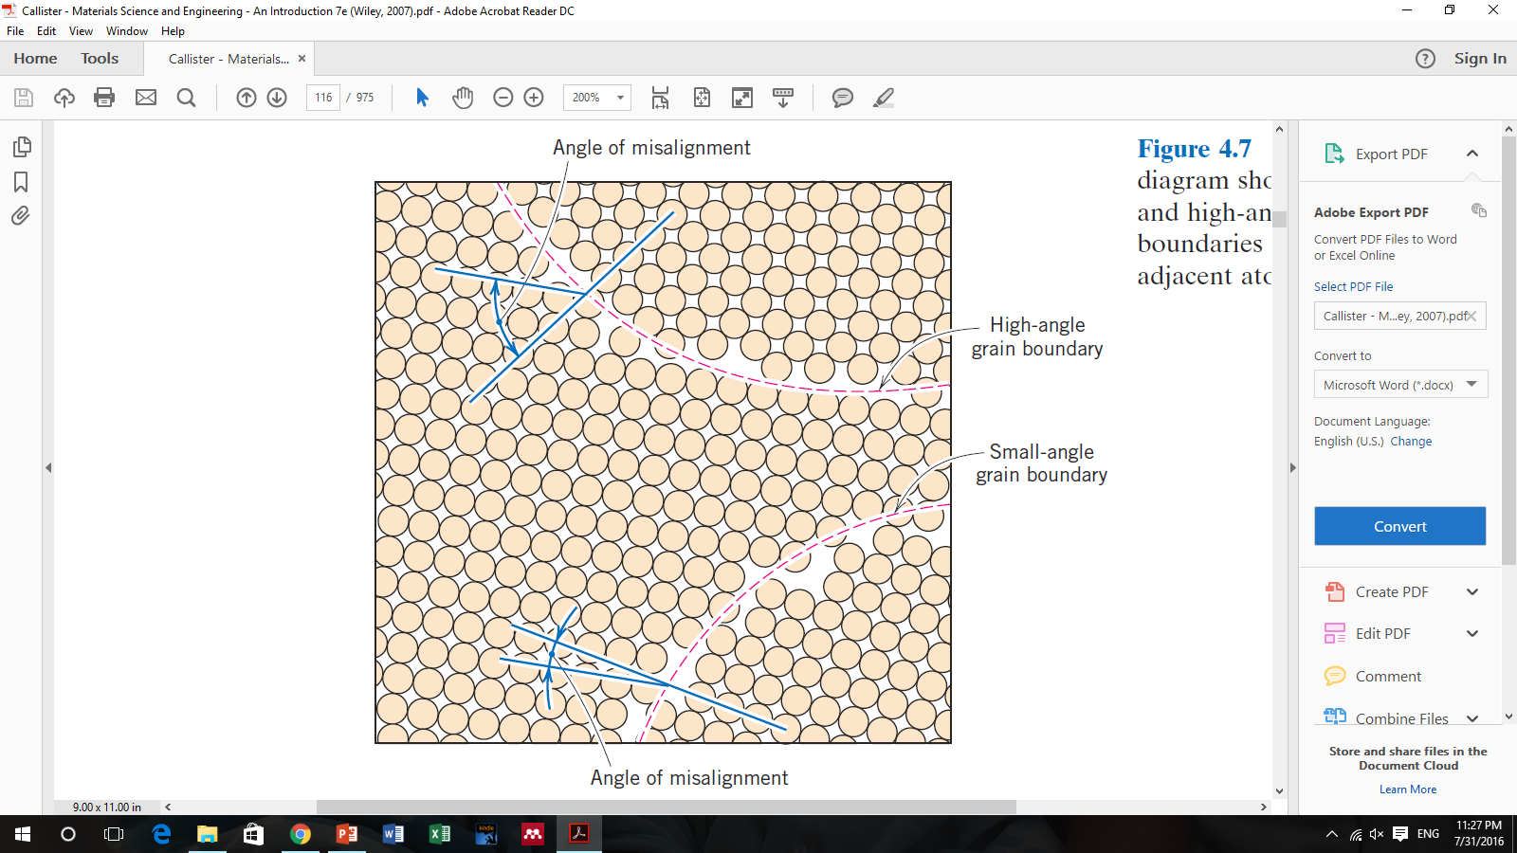
Dislocations—linear defects
A dislocation is a linear or one-dimensional defect around which some of the atoms are misaligned.
Interfacial defects – Grain Boundaries
Another interfacial defect, the grain boundary, as the boundary separating two small grains or crystals having different crystallographic orientations
Bulk or volume defects
Other defects exist in all solid materials that are much larger than those heretofore discussed. These include pores, cracks, foreign inclusions, and other phases. They are normally introduced during processing and fabrication steps.

Slide 24
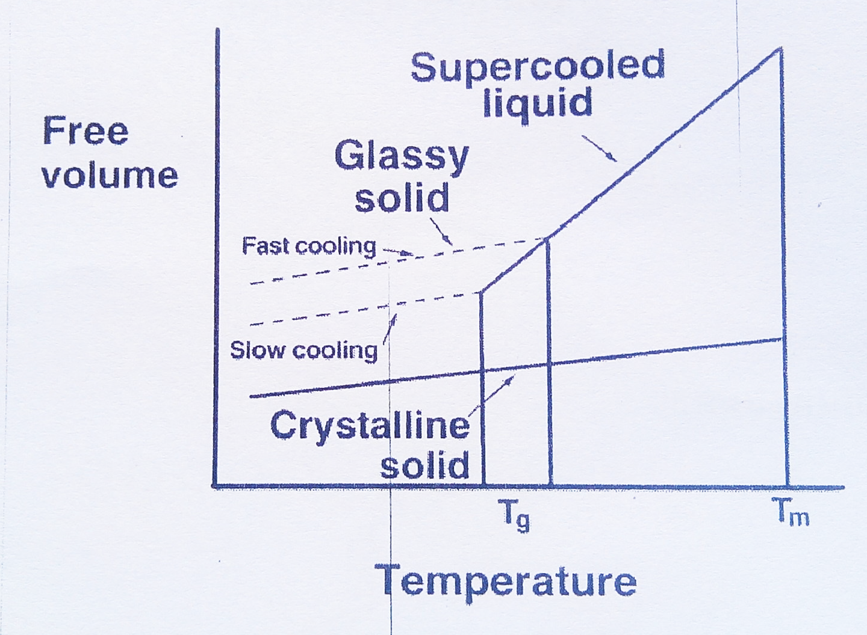
Glass
Glass is a supercooled liquid. Glass is made by quenching liquid state of glass, so solid glass maintains the liquid like molecular structure.
Glass has amorphous structure
Since it’s a metastable structure, glass tends to crystallize over time
Polymers can easily made into amorphous phase, since the chains are less mobile and if cooled fast they don’t get enough time to crystallize.
Metal glass has been made but extremely difficult to make.
Gorilla glass gets its strength through an interesting chemical process. Corning dips each sheet into a molten salt bath where a chemical exchange occurs. Potassium ions are infused into the glass. At the same time, sodium ions exit the glass.

Slide 25
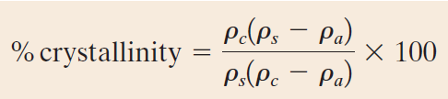
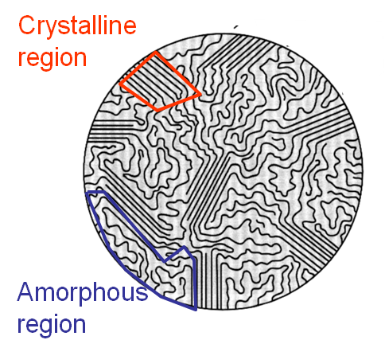
Structure of Polymers
Polymers are long chain molecules bonded by covalent bonds along the back bone chain.
Long chains are held together by secondary bonding forces such as van der Walls and hydrogen bonds
Polymers can have both crystalline and amorphous regions
Where:
ρ_{s} is the density of a specimen for which the percent crystallinity is to be determined,
ρ_{a} is the density of the totally amorphous polymer, and
ρ_{c} is the density of the perfectly crystalline polymer
Problem: If the density of ultrahigh molecular weight polyethylene (UHMWPE) is 0.93 g/cm³. Calculate the percent crystallinity of UHMWPE assuming 100% amorphous and 100% crystalline UHMWPE have densities of 0.85 and 1.01g/cm³, respectively.
(Ans: 54.30%)

Slide 26
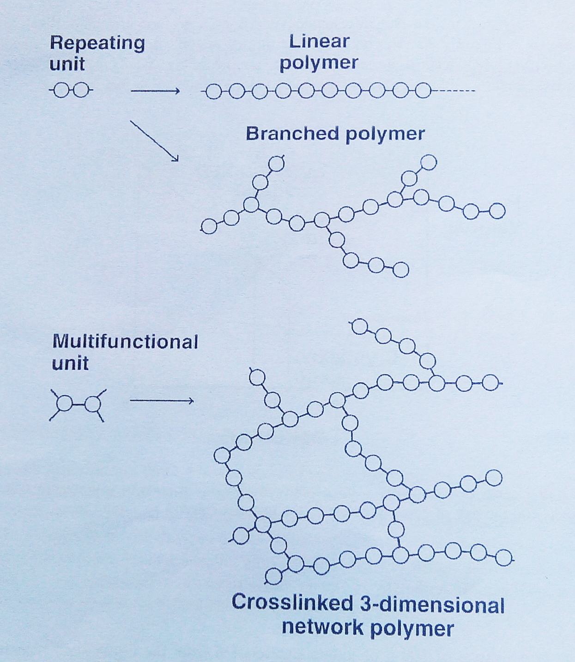
Type of polymer chains:
Linear polymer
Branched polymer
Crosslinked polymer
Branches lower crystallinity of polymer. Cross linked polymers have amorphous structure.
Longer chains are less mobile so difficult to crystallize

Slide 27
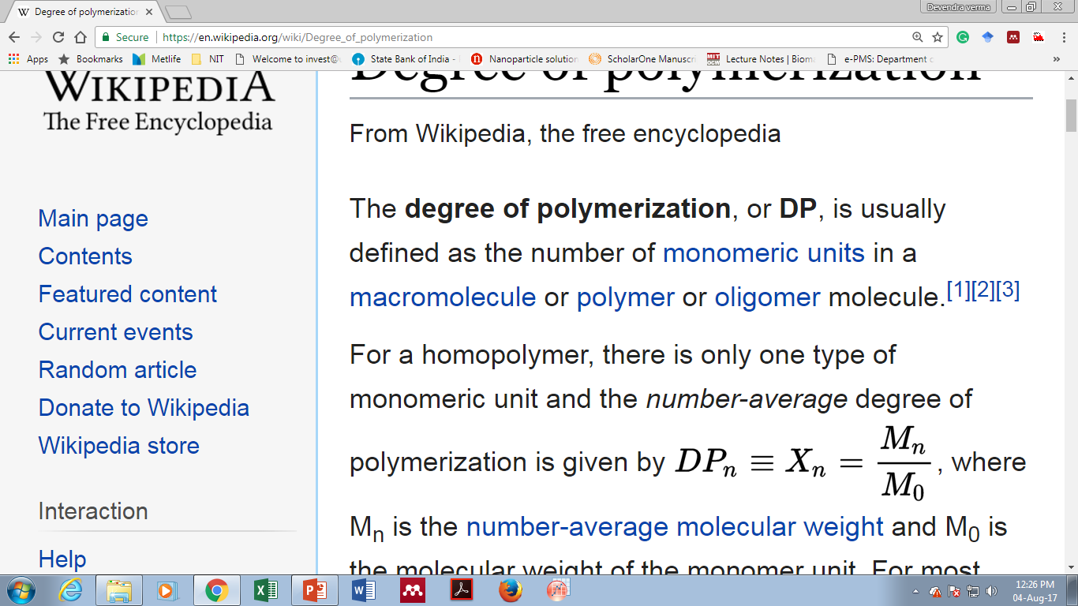
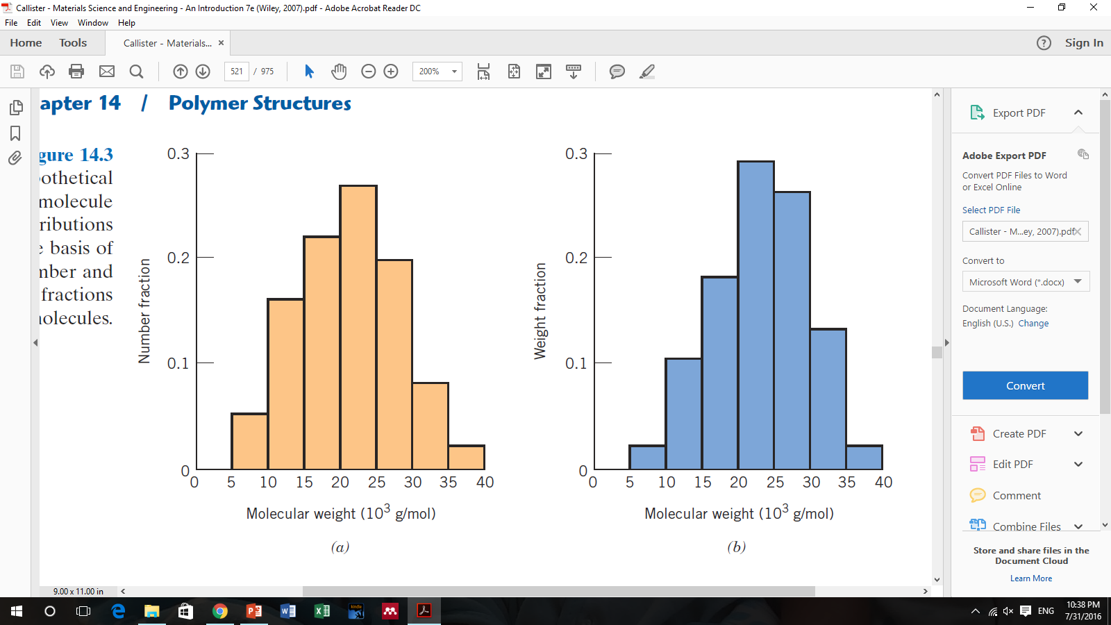
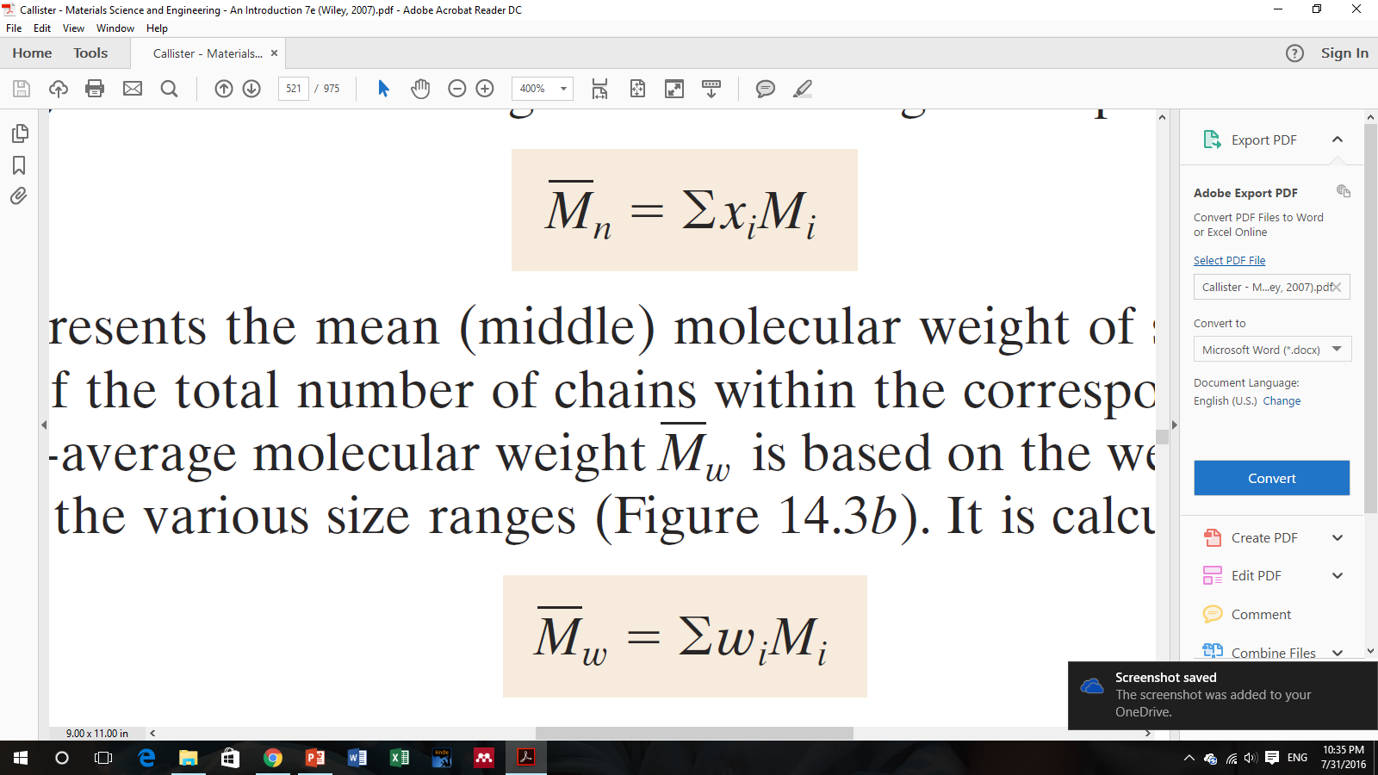
Molecular Weight of polymers
Degree of polymerization (DP) is one of the most important parameters in determining properties of polymers. It is defined as average number of mers per molecule
The relationship between DP and MW can be expressed as:
where M_{n} is the number-average molecular weight and M₀ is the molecular weight of the monomer unit.
The number-average molecular weight is expressed as
A weight-average molecular weight is based on the weight fraction of molecules within the various size ranges. It is calculated according to:
Mechanical Strength increases with molecular weight but there is no effect of molecular weigth on elastic modulus.

Slide 28
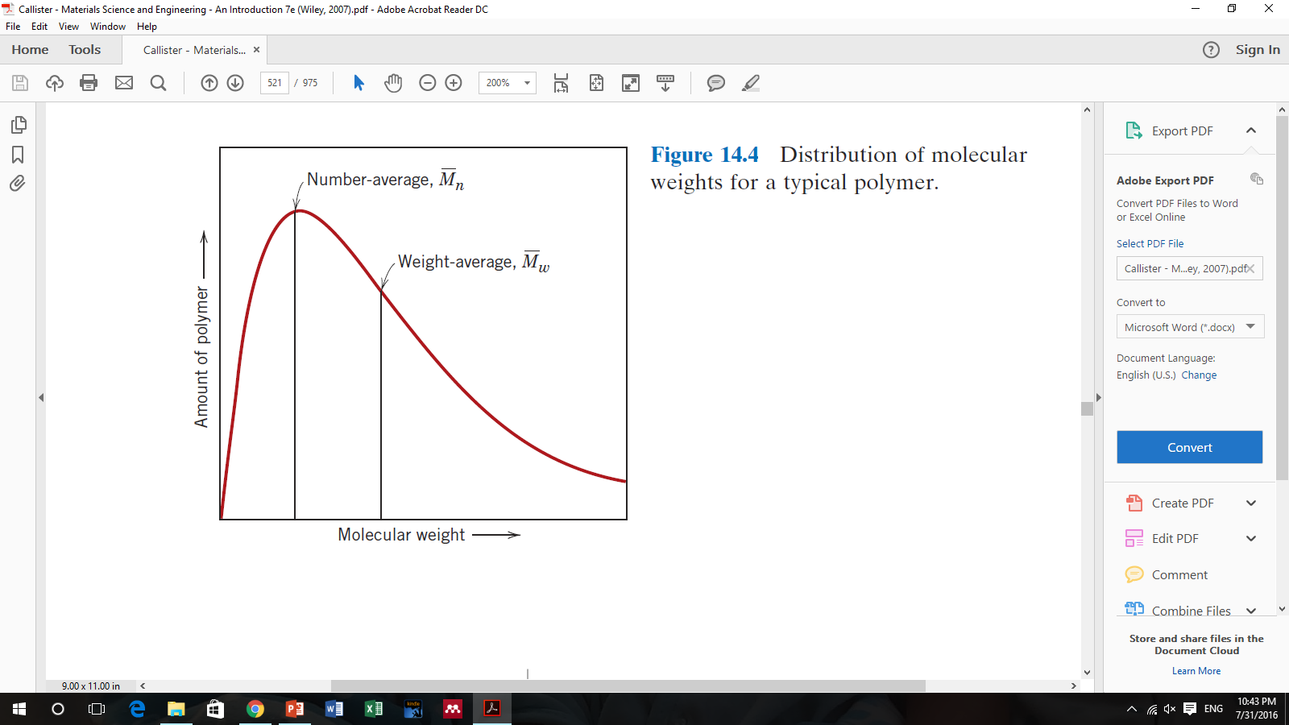
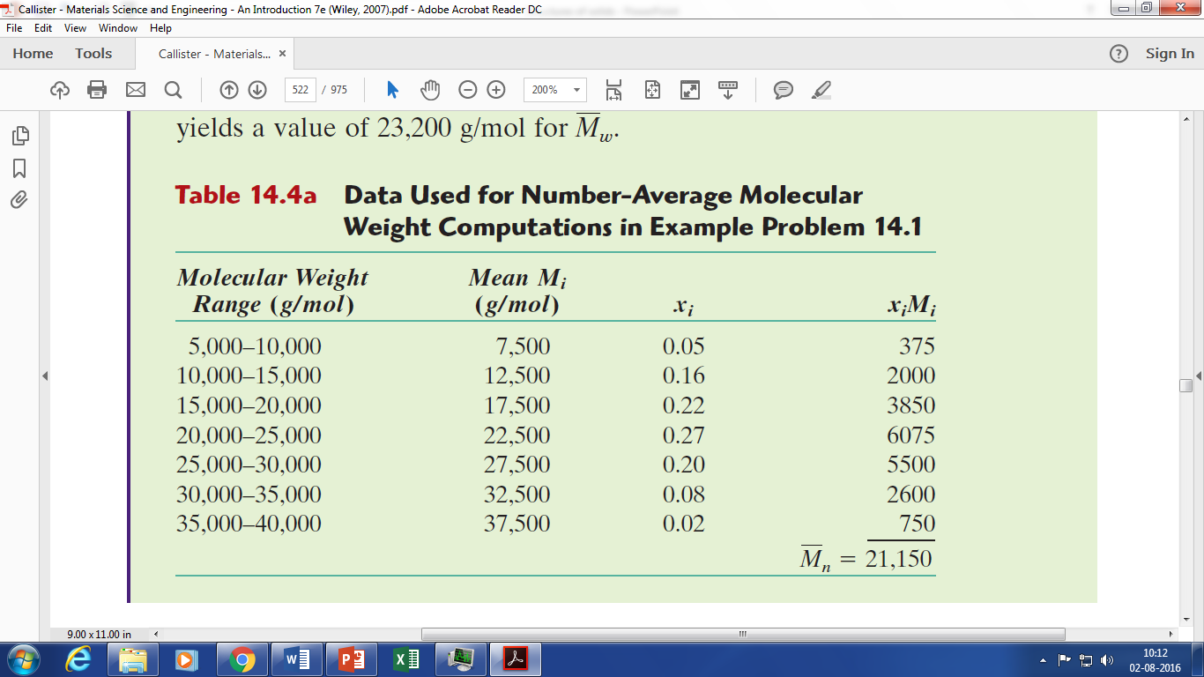
Distribution of molecular weights for a typical polymer
Problem: Assume that the molecular weight distributions shown in table below, are for poly(vinyl chloride) (molecular weight of PVC mer is 62.50 g/mol). For this material, compute (a) the number-average molecular weight, (b) the degree of polymerization.
Ans: (a) 21,150 g/mol (b) 338

Slide 29
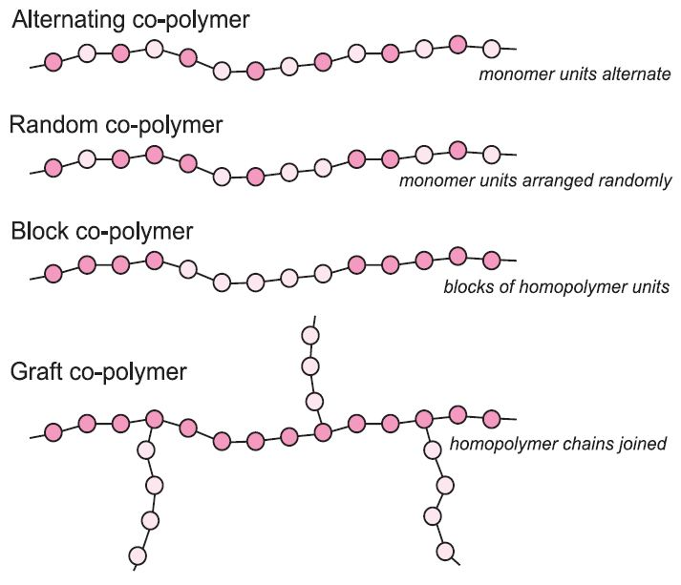
Types of Co-polymers

